Slide 1

The Burning issue of Garbage Collection
Building a safer, healthier planet for the future generations is in your hands

Slide 2
WHAT IS THE PROBLEM?
BURNING = CANCER!
Dioxin and other dangerous toxins created by plastic burning, rubber or other man-made materials
Dioxins – Invisible but a slow, deadly killer
What is safe to burn?
Burning leaves, plant clippings, paper, cardboard less hazardous than plastics – but not healthy
Open defecation and Open drain positions – a threat to public health

Slide 3
GARBAGE BURNING CRISIS
41 percent of our global 2 billion-ton annual output goes up in flames
29 percent of global particulate matter called PM 2.5, which can penetrate deep into the lungs, comes from such fires, as well as 10 percent of toxic mercury emissions.
A new study shows that rampant trash-burning is releasing more polluting emissions than governments are reporting.
The researchers estimate about 41 percent of the world's garbage is burned in backyards, fields, dumps or incinerators.

Slide 4
OPEN DEFACATION CRISIS
There are one billion people who do not have a toilet, and Indians make up 60 percent of this number.
Of this 60 percent, the majority comes from rural areas.
Effect of the problem:
There have been hundreds of cases of women being raped as they leave their homes after dark.
Human feces are not easily kept away from fields, wells and food.
Range of health problems from diarrhea to enteropathy, a chronic sickness that prevents the absorption of calories and nutrients.
50% of children malnourishment attributed to Open defacation

Slide 5
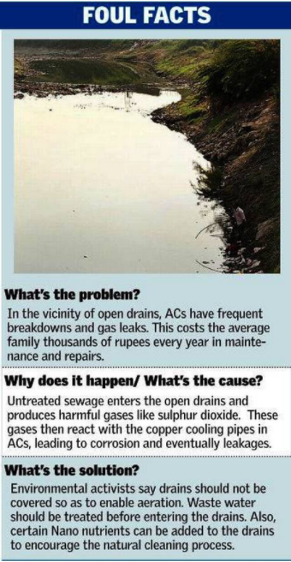
OPEN DRAIN CRISIS
In a study conducted across three unauthorised colonies in the capital, it was found that the incidence of diarrhoea among children was closely related to the lack of safe excreta disposal systems.
India reported the highest number of deaths caused by diarrhoea and pneumonia among children under the age of five, globally.
The uncovered drains not only stink, they also endanger public health and the environment. And with roughly 50 per cent of all drains being uncovered, the problem is huge.

Slide 6
DATA RELATED TO GARBAGE AT BAGESHWAR DISTRICT

Slide 7
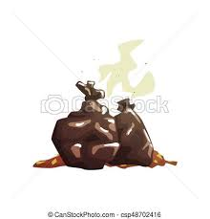
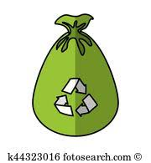
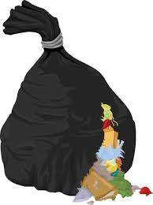
8 out of 10 – Burn Garbage 1 out of 10 – Throw out garbage 1 out of 10 – Doorstep pick up

Slide 8
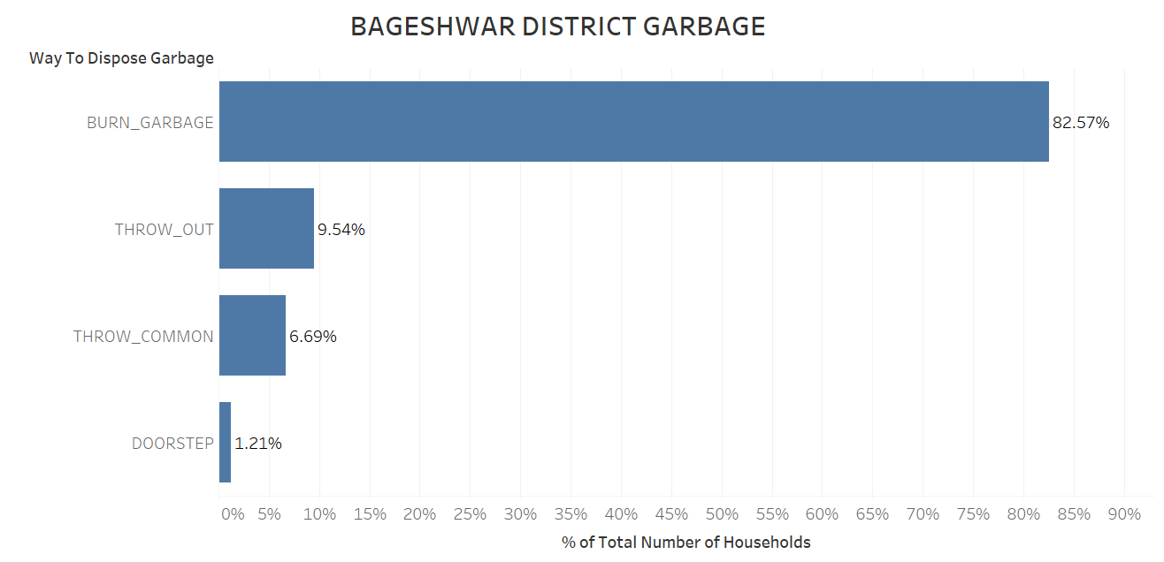
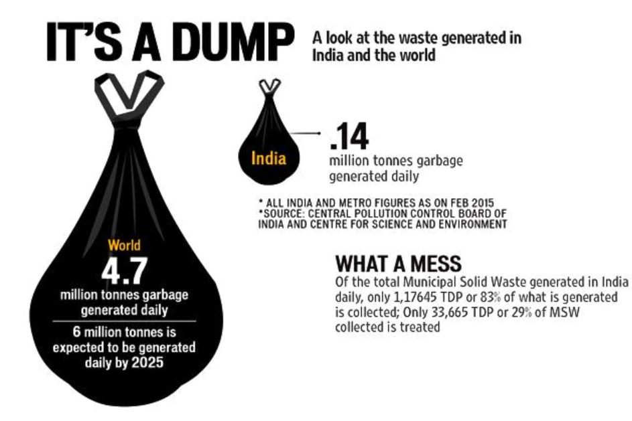
INFERENCES DRAWN FROM THE DATA

Slide 9
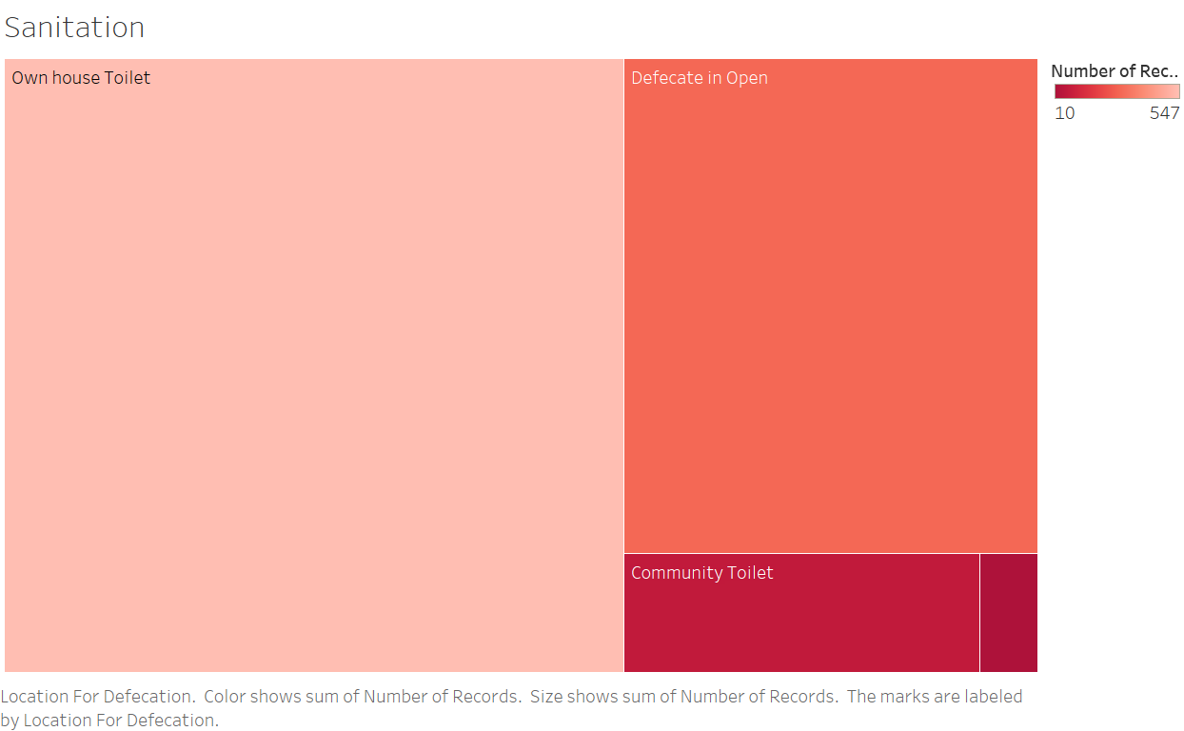
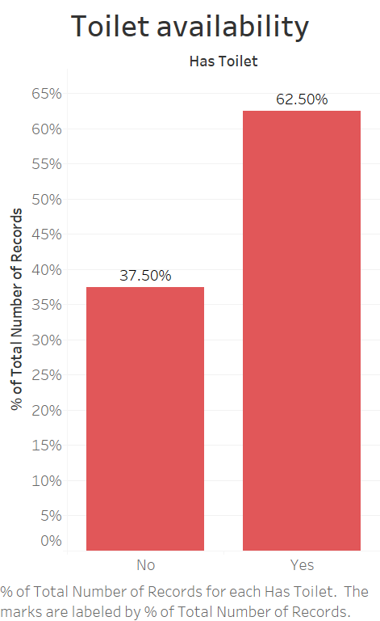
2nd finding: Sanitation conditions

Slide 10
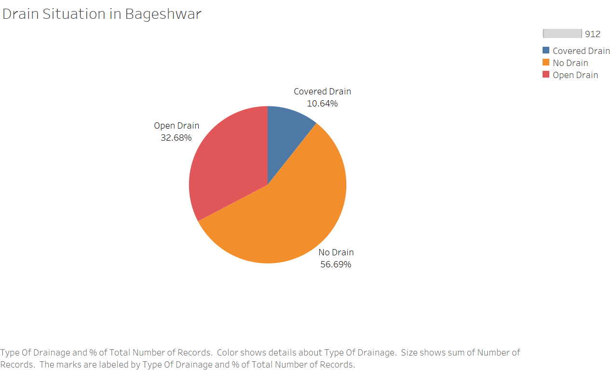
3rd finding: Drain conditions

Slide 11
GOLD IN WASTE?
By 2050, waste is expected to rise to 436 million tons.
The waste management market is expected to be worth $13.62 billion by 2025, with an annual growth rate of 7.17%.
Environment solutions startups work together to combine the power of business with innovation to provide solutions.
“Our portable biogas model (20-250 kg per day) has achieved its aim of making a profit within Mumbai and outside it as well. We are all set to install a 5,000 kg per day biogas plant in Rajkot Municipal Corporation” - Debartha Banerjee, cofounder of environment solutions startup Sampurn(e)arth.

Slide 12
GARBAGE MANAGEMENT– A GOOD INVESTMENT OPPORTUNITY
In India, metropolitan areas and major economic hubs generate maximum volumes of waste.
While all start-ups focus on these areas, focus on smaller districts such as Bageshwar could be potential investment idea.
How?
Associate with scrap dealers and waste-pickers, authorized recyclers, waste generators, and citizen groups.
Cleanliness drive, organizing street plays to raise the awareness
“Waste management in India is getting more importance and relevance under the Swachh Bharat campaign, but finding the right technology and striking the right business model can only help the initiatives to scale up” – Investor in waste management industry

Slide 13
APPEAL TO PHILANTHROPISTS
Though there are 3 problems highlighted in this study, focus on investments in garbage management has been the conclusion of the study.
Bageshwar requires better garbage handling mechanisms.
Hundreds of thousands with no garbage pickup and have no other choice for disposal.
As temperatures dip in winter, they often have few other options for keeping warm, and many spend their nights huddled around noxious blue flames coming off humble pyres of burning plastic bags, rubber tires and whatever else they can find handy to burn.
Due to lack of data, reliable estimates are hard to come by in developing countries. But this study shows that more than 80% of the households resort to garbage burning.
Investments in this sector will help Bageshwar and thus India take the first step towards fighting pollution and cleanliness.
Open burning of waste is harmful and is an emerging crisis humanity is already facing

